Slide 1


“Advanced C Programming”
eDiploma-2021

Slide 2
Code Optimization

Slide 3
Introduction
Optimization:
It is the process of transforming the program to improve its efficiency
Efficiency: It will be measured by,
Performance:
Faster execution → CPU
Size:
Smaller executable
Smaller memory footprint → Memory (RAM)

Slide 4
Optimization - Roles
Programmer
Innovative algorithms
Intelligent coding
Compiler
Choice of instructions
Moving code
Reordering code
Strength reduction
Many more…
Processor
Pipelining
Multiple tasks
Memory accessing
Parallelizing etc..
Rest of the system: we may not able to control…

Slide 5
Optimization Techniques
Redundancy elimination
Constant Folding
Constant propagation
Copy Propagation
Algebraic Simplifications
Strength Reduction
Dead Code Elimination
Structure Simplifications
Common sub-expression elimination
Loop Optimizations
Code Inlining

Slide 6
1. Redundancy elimination
Definition: Finding out the duplicate computations and eliminating the duplications.
Types of redundancy elimination:
Value numbering
Associates symbolic values to computations and identifies expressions that have the same value
Common sub-expression elimination
Identifies expressions that have operands with the same name
Constant/Copy propagation
Identifies variables that have constant/copy values and uses the constants/copies in place of the variables.
Partial redundancy elimination
Inserts computations in paths to convert partial redundancy to full redundancy.

Slide 7
2. Constant Folding
Constant folding: Evaluation of an expression with constant operands to replace the expression with single value → Replace a constant expression with its value
Example:
area := (22.0/7.0) * r ** 2
area := 3.14286 * r ** 2
Evaluate constant expressions at compile time
“Only possible when side-effect freeness guaranteed” → We may lose accuracy

Slide 8
3. Constant propagation
Constant Propagation: Replace a variable with constant which has been assigned to it earlier.
Examples:
(a)
pi = 3.14286;
area = pi * r ** 2;
area = 3.14286 * r ** 2;
a= 2;
b = 6;
count = a+b;
for(i=0; i<count; i++)
a= 2;
b = 6;
count = 8;
for(i=0; i<count; i++)
(b)

Slide 9
4. Copy Propagation
Copy Propagation: Given an assignment x=y, replace later uses of x with y, if there are no intervening assignments to x or y.
Example:
In a statement x = y, replace later uses of x with y, if x and y have not been changed.
X[i] = a;
Sum = x[i] + b;
X[i] = a;
Sum = a + b;
Analysis needed, as y and x can be assigned more than once!

Slide 10
5. Algebraic simplifications
Definition: Use algebraic properties to simplify expressions
-(-i)
i
If(x | 1)
If( 1 )
Important to simplify code for later optimizations

Slide 11
5. Algebraic simplifications…
1
x = a + b
2
a = b
3
z = a + b + 10
4
“a + b” is not a common sub-expression in 1 and 4
None of the variable involved should be modified in any path

Slide 12
6. Strength reduction
Definition: Replace expensive operations with simpler ones
Example: Multiplications (*) replaced by addition (+)
y = x * 2
y = x + x

Slide 13
7. Dead Code Elimination
Definition: Dead Code are portion of the program which will not be executed in any path of the program. Removing such portions of code is called as dead code elimination.
Examples:
If control does not go into a basic block, remove it.
A variable is dead at a point -> its value is not used anywhere in the program
An assignment is dead -> assignment assigns a value to a dead variable

Slide 14
7. Dead Code Elimination…
“x” is dead variable
Definition of “x” is dead
x = y - 5
Beware of side effects in code during dead code elimination

Slide 15
7. Dead code elimination…
Remove unnecessary code
Example1: variables assigned but never read
x = 8;
c = a + 8;
d = 3 + c;
c = a + 8;
d = 3 + c;
Example2: Remove code never reached
if (false) {a = 5}
if (false) {}

Slide 16
8. Structure Simplification
Similar to dead code: Simplify Complex Structures
Optimizations will degenerate simplified structures
Needs to be cleaned to simplify further optimization!

Slide 17
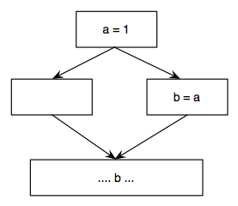
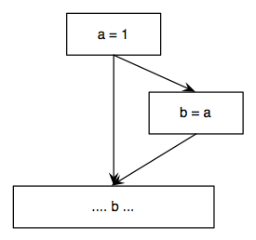
8. Simplify Structures…
Delete empty basic blocks
Empty basic
block

Slide 18
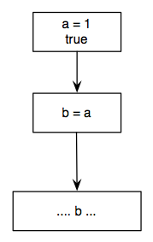
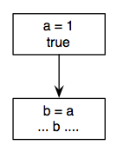
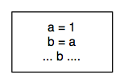
8. Simplify Structures…
Fuse basic blocks

Slide 19
9. Common sub-expression elimination
Common Sub-expression:
There is another occurrence of the expression whose evaluation always precedes this one
Operands remain unchanged
Types:
Local - Inside one basic block
Global - Complete flow-graph

Slide 20
9. Local Common sub-expression elimination…
Local common sub-expression elimination
Performed within basic blocks
Algorithm:
Traverse Basic Block from top to bottom
Maintain table of expressions evaluated so far
if any operand of the expression is redefined, remove it from the table
Modify applicable instructions as you go
Generate temporary variable, store the expression in it and use the variable next time the expression is encountered.
t = a + b
x = t
...
y = t
x = a + b
...
y = a + b

Slide 21
9. Common sub expression elimination…
Identify common sub-expression present in different expression, compute once, and use the result in all the places.
The definition of the variables involved should not change
Example 2:
a = b * c; temp = b * c;
… a = temp;
… …
x = b * c + 5; x = temp + 5;

Slide 22
10. Loop Optimization
Normally, Loops are the most expensive blocks in a C program. The following are the common techniques followed to optimize the loops.
Techniques:
Code motion
Induction variable elimination

Slide 23
a) Code Motion
Moving code from one part of the program to other without modifying the algorithm
Reduce size of the program
Reduce execution frequency of the code subjected to movement

Slide 24
a) Code Motion…
Code Space reduction: Similar to common sub-expression elimination but with the objective to reduce code size.
Example: Code hoisting
for(i=0; i<n; ++i) temp = x ** 2
{
if (a< b) then if (a< b) then
z = x ** 2 z = temp
else else
y = x ** 2 + 10 y = temp + 10
}
“x ** 2“ is computed once in both cases, but the code size in the second case reduces.

Slide 25
b) Induction variable optimization
Values of variables form an arithmetic progression
int a[100];
for(i=1; i< 100; i++)
{
a[i] = 202 – 2 * i;
}
int a[100];
t1 = 202;
for(i=1; i< 100; i++)
{
t1 = t1 – 2;
a[i] = t1;
}
value assigned to a
decreases by 2
Uses Strength Reduction
(Introduce a new variable)

Slide 26
11. Code Inlining
All optimization up to know where local to one procedure
Problem: procedures or functions are very short
Especially in good C code!
Solution: Copy code of small functions into the caller
a = pow(n);
pow(x) {
return (x*x);
}
a = n * n;

Slide 27
Thank You

